Slide 1
MAR 580: Models for Marine Ecosystem Based Management
Lecture 5
Multispecies models, estimating species interactions, multispecies policy advice
04 March 2016

Slide 2
Simplified Schedule
Week | Topic | Assignments
1/29 | Intro to EBM, review of fisheries assessment models
2/5 | No Class - weather
2/12 | Stock assessment models with ecosystem processes
2/19 | Guest lecture: Food web models I (Ecopath) | HWK 1 due
2/26 | Guest lecture: Food web models II (Ecosim) | Project outlines
3/ 4 | Multispecies models, estimating species interactions
3/11 | Marine spatial planning models, marine reserve design | HWK 2 due
3/18 | SPRING BREAK
3/25 | No Class - IMS Research Symposium (several mini-lectures) | HWK 3 due
4/1 | Valuation of ecosystem services
4/8 | No Class – Stock Synthesis training course | HWK 4 due
4/15 | Whole of system models, MSE for ecosystems
4/22 | Qualitative modeling, model structure uncertainty | HWK 5 due
4/29 | Participatory modeling, multicriteria decision analysis
5/6 | Final exam: Project Presentations | Final papers

Slide 3
Today’s Outline
Multispecies modeling
Minimal Realistic Models
Roles for MRMs
Multispecies policy advice
LAB / ASSIGNMENT
Size-dependent predation
Introduction to MARSS package in R
Fishery policy evaluation using Ecosim

Slide 4
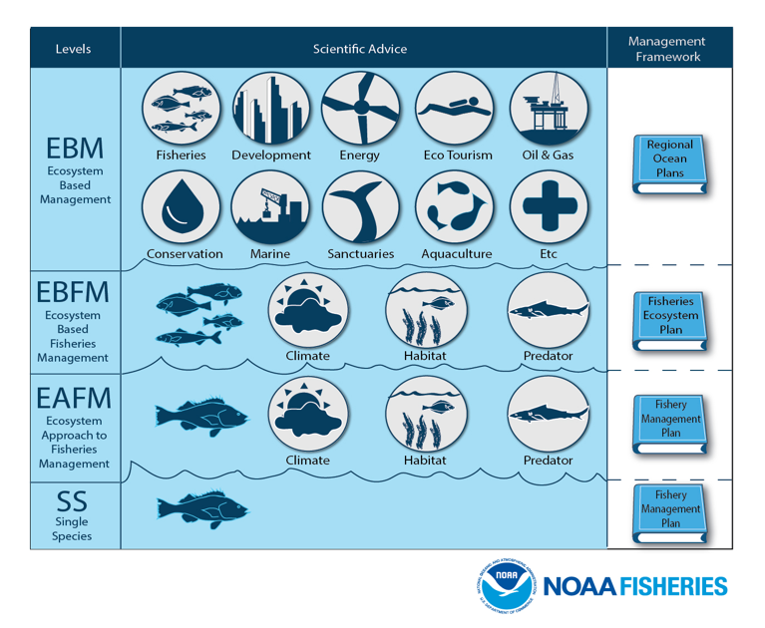

Slide 5
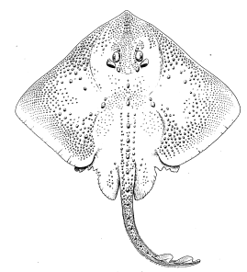
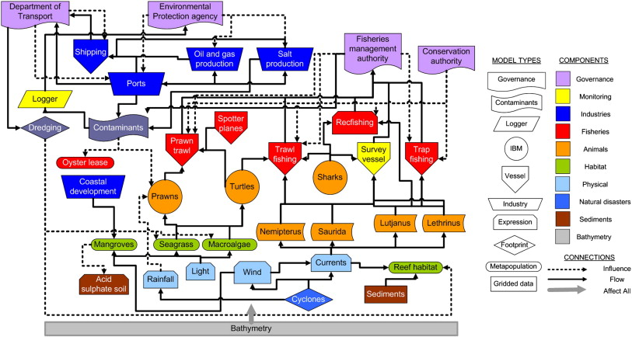
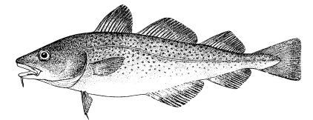
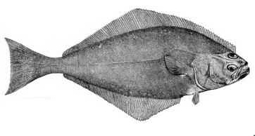
Gradient of possible modeling tools
Stock/Single Species
Multi-species
Aggregate Biomass
Ecosystem
Gadids
Pelagics
Flatfish
Single species models, forget ecosystem issues
food web models
Multi-species assessments
Extended single species models with predation mortality, habitat or climate effects
Whole system models
Aggregate Biomass Models
Multiple single species assessments in “harmony”

Slide 6
(almost) all you ever need to know for Population Modeling
Numbers next year = numbers this year
+ births – deaths + immigrants – emigrants

Slide 7
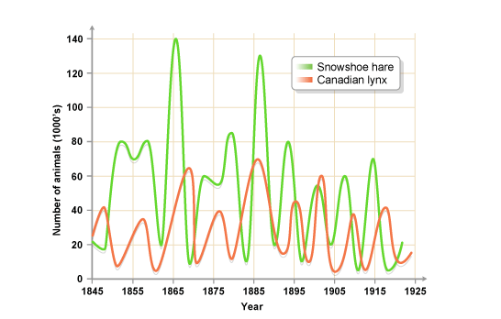
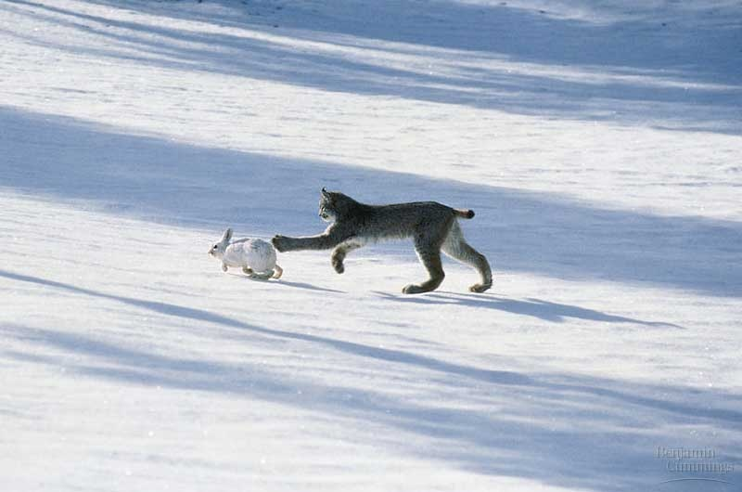
Multispecies models
Effectively a set of single species models with some form of linkage between them, usually species interactions, all modeled simultaneously.
Image from: http://www.anselm.edu/homepage/jpitocch/genbios/52-19a-PopCycleHareLynxPhot.jpg
Image from bbc.co.uk

Slide 8
Multispecies models
Models of multispecies dynamics have been around for a long time (e.g. Lotka 1910).
Add species interactions to simultaneous sets of population dynamics.
Lotka-Volterra Predator-Prey

Slide 9
Adding interactions to the logistic model
Competition
We can add interaction terms to ‘simple’ production models.
e.g. Lotka-Volterra competition terms to the logistic model. Here the α’s are positive.
(representing negative effects of species on eachother)
There are a myriad of ways for including these terms – choices should ideally be driven by some understanding of the system.
Here we model a Type II functional response in the consumption of prey N by predator P.
This is more realistic than the Lotka-Volterra equations as it implies saturation in the per capita predator consumption.
Predation

Slide 10
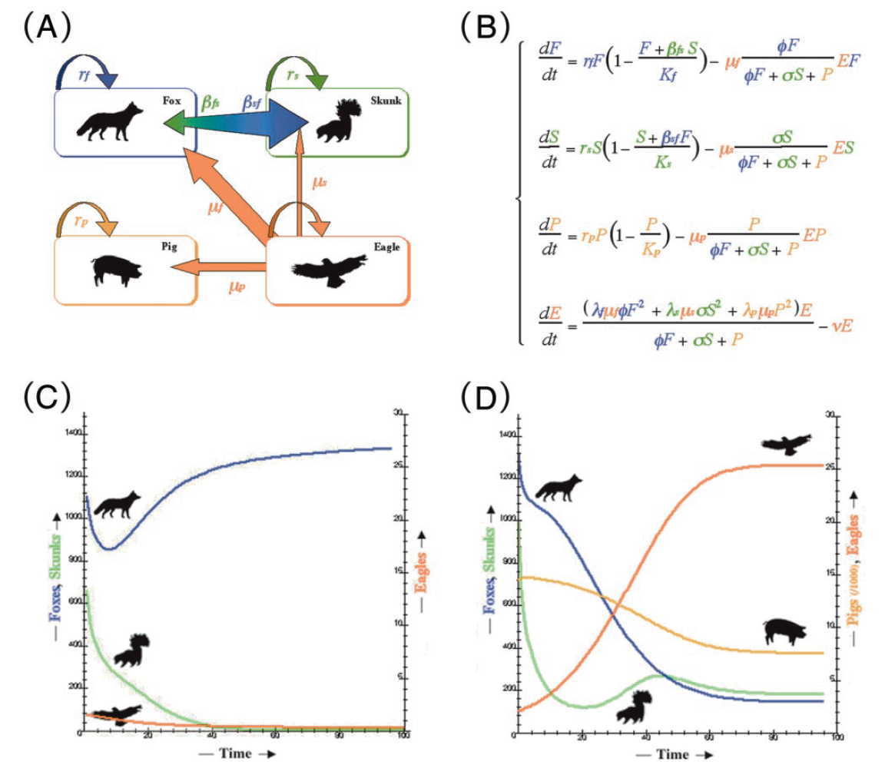
A simple multispecies model
Multispecies equations
Channel Islands: introduced feral pigs allowed golden eagles to establish and increase, greatly increasing predation (hyperpredation) on native foxes. Low fox numbers allowed competitively inferior skunks to flourish.
No pigs
Pigs
From Branch
Roemer, G.W., Donlan, C.J., and Courchamp, F. 2002. Golden eagles, feral pigs, and insular carnivores: How exotic species turn native predators into prey. Proc. Natl Acad. Sci. U.S.A. 99(2): 791-796.

Slide 11
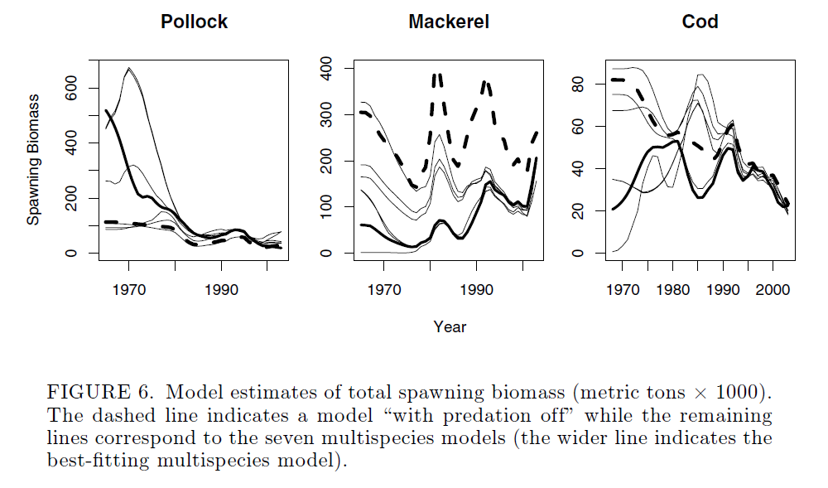
Choice of functional response can greatly influence model behavior, yet not always be easy to identify.
Models sensitive to form of functional response describing predator-prey dynamics.
Kinzey & Punt (2009) Multispecies and single-species models of fish population dynamics: comparing parameter estimates. Natural resource modeling 22: 67-104.

Slide 12
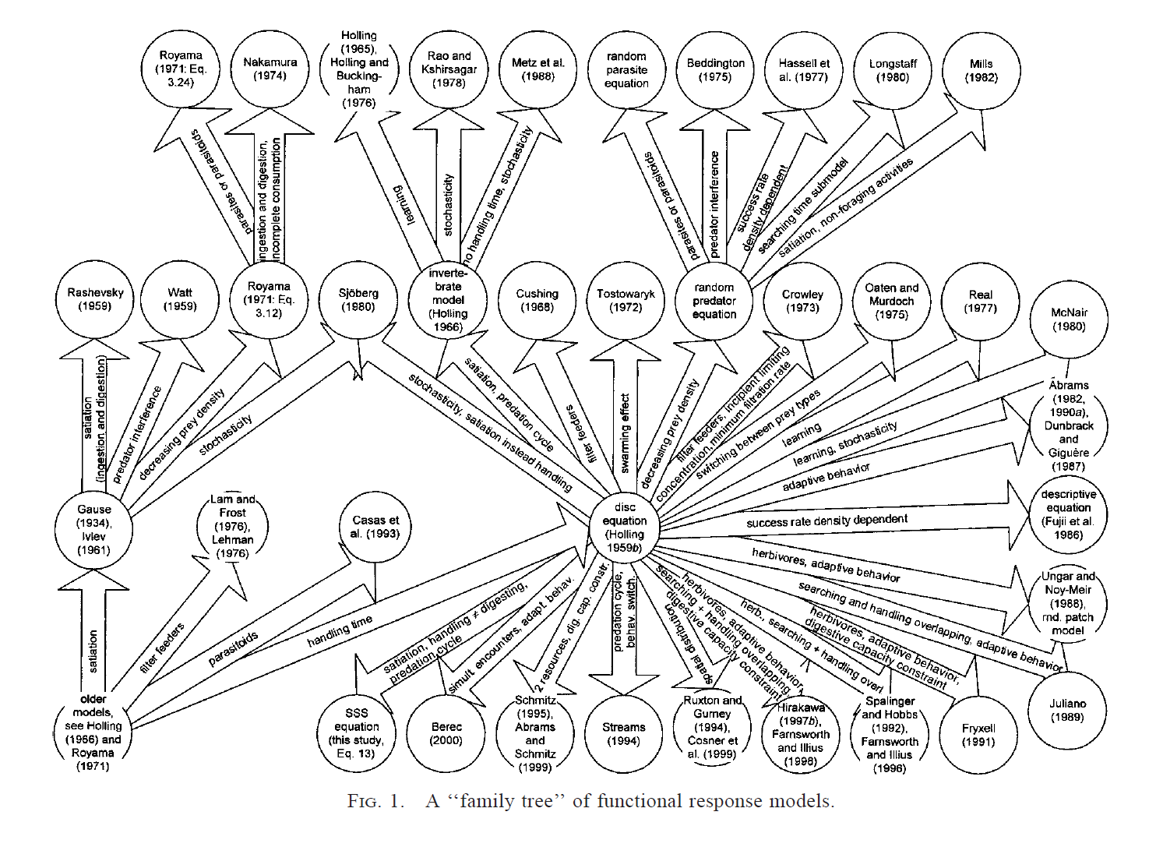
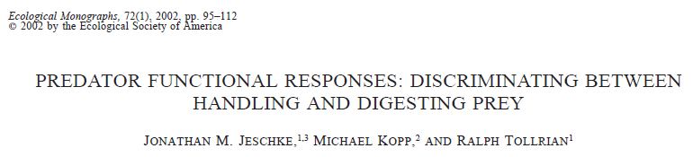

Slide 13
Multispecies Fisheries Production Models
Several instances of these models being applied.
Pooled biomass dynamics versions have not tended to be fit to data, rather rely on auxiliary information for parameterization.
Length structured versions have.
Gamble, R.J. and J.S. Link. 2009. Analyzing the tradeoffs among ecological and fishing effects on an example fish community: A multispecies (fisheries) production model. Ecol. Mod. 220: 2570-2582.

Slide 14
Stage-structured multispecies models
Like their single-species counterparts, these models include population structure such as age/length.
Species interactions can then be length or age dependent.
More realistic, big fish eat small fish….
The focus of these models has primarily been on trophic interactions.
Predation mortality
Prey-dependent growth largely not included.

Slide 15
Stage-structured multispecies models
Modeling predation via M2
M2 essentially treated as another fishing fleet, but with functional response replacing selectivity.

Slide 16
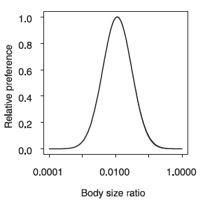
Modeling predation mortality
Size-based approaches (e.g. Hall et al. 2006)
Take advantage of scaling relationships associated with growth, consumption, and size ratios between predator and prey species.
Dramatically reduces number of parameters
Alternative is to estimate functional response parameters based on stomach contents data
Ration can be derived from growth curve, or a function of covariates.
Require ‘other food’ component.
Hall et al. (2006)

Slide 17
Multispecies Virtual Population Analysis (MSVPA)
Suitability
Parameters
Diet Data
Consumption = Predator BM * %DR
Other Food
P_{prey} = (Suitable Biomass)_{prey} / Total Suitable Biomass
M2_{age}
C_{prey} = Consumption * P_{prey}
M2_{prey} = C_{prey} / BM_{prey}
BM_{age}
BM_{age}
BM_{age}
BM_{age}
BM_{age}
Other
Predators
Single Species VPA
Adapted from Garrison et al.

Slide 18
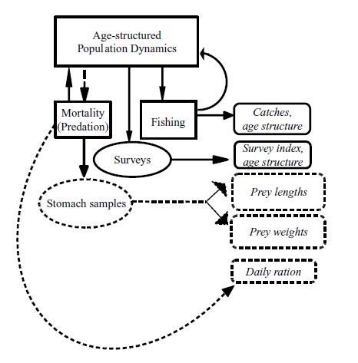
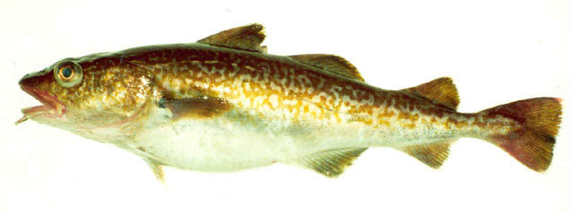
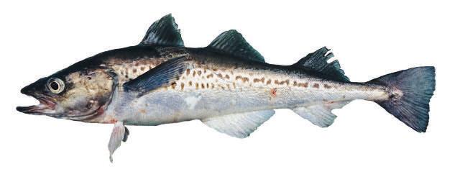
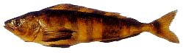
Multispecies statistical catch-at-age models
Simultaneous stock assessments of multiple species fitted to numerous data, including diet information.
e.g. Aleutian Islands groundfish fishery (Kinzey & Punt 2009).
Walleye pollock, Atka mackerel, and Pacific cod interact as predators and prey.
See also: Curti et al. (2013) ICES (2010) - (SMS model) Van Kirk et al. (2010, 2012)

Slide 19
Barents Sea Minke Whales-Cod-Capelin EXAMPLE
Several models:
GADGET,
BORMICON,
MULTSPEC, etc.
Explores tradeoffs among 4 main species interactions.
Environment and fishing contrasted.
Bogstad, B., Hauge, K. H., & Ulltang, Ø. (1997). MULTSPEC–a multi-species model for fish and marine mammals in the Barents Sea. Journal of Northwest Atlantic Fishery Science, 22(317-341), 1-1.

Slide 20
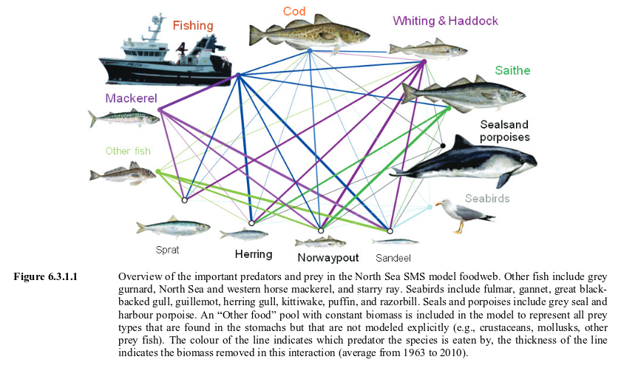
North Sea SMS model (ICES 2010, etc.)

Slide 21
Estimating parameters
Previous models require typical stock assessment data, plus either:
Assumptions about ecological relationships
Stomach contents data
Alternative approaches to estimating parameters for multispecies models are less mechanistic:

Slide 22
Multivariate autoregressive (MAR) models
Take the form
B matrix can be VERY big
Simplified dynamics
Estimating parameters is often non-trivial
MARSS package in R uses EM algorithm to do maximum likelihood estimation.
e.g. Ives et al. 2003 Ecol. Monographs, Holmes et al. 2012. R journal.

Slide 23
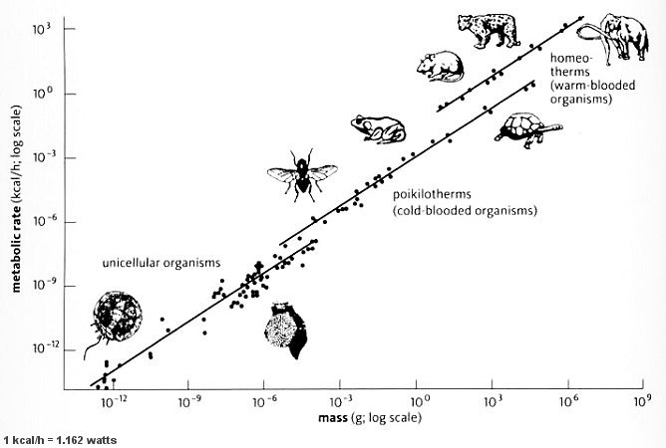
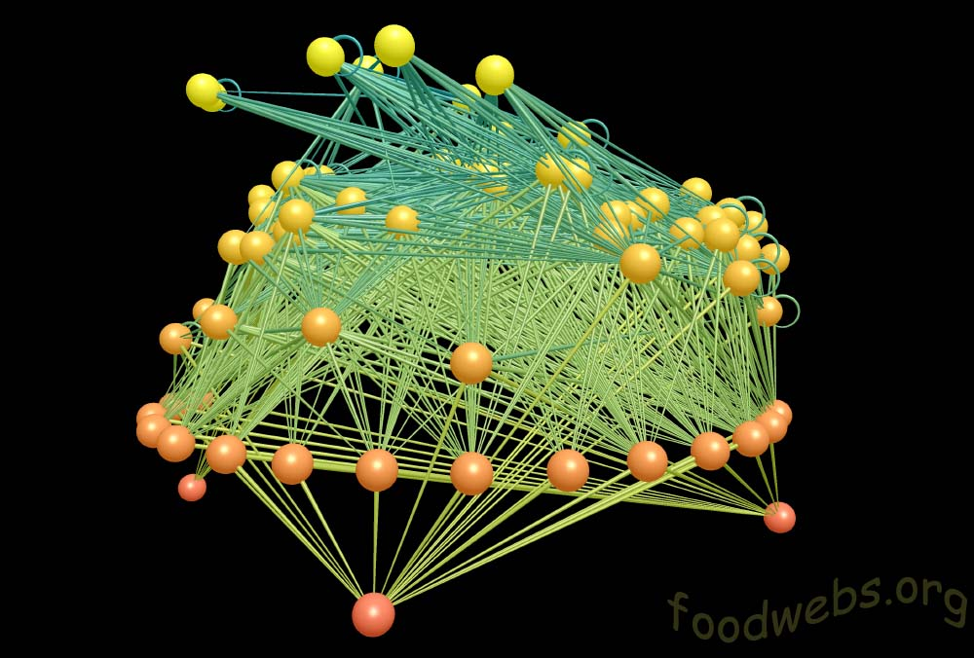
Food web models based on metabolic scaling
Make use of metabolic scaling theory to determine biological dynamics
e.g. Kleiber’s law
Used to compare empirical data with theoretical structures (network theory)
Understand role of structure in behavior of foodweb
Connectance
Robustness to perturbation
Simple rules to connect foodwebs
e.g. trophic niche model
e.g. Dunne et al. 2004. MEPS.
Image produced with FoodWeb3D, written by R.J. Williams and provided by the Pacific Ecoinformatics and Computational Ecology Lab (www.foodwebs.org, Yoon et al. 2004).

Slide 24
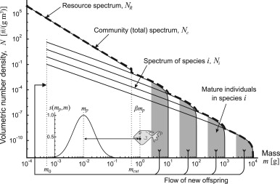
Size spectra models
Simple metabolic models.
Feeding ecology based on theoretical size-based relationships
Focus on size distribution of communities rather than individual species.
Model evaluation by changes to the slopes of the size spectra.
Hartvig et al. 2011

Slide 25
Minimal Realistic Models a.k.a. Models of Intermediate Complexity
(Plagányi et al. (2014)
Objective of these models is to consider the interactions among a small number of species and components.
Focus on ‘key’ system properties/components relevant to the research or management questions.
May include a suite of model types for each component.
Perhaps statistically estimate model parameters using data similar to single-species models.

Slide 26
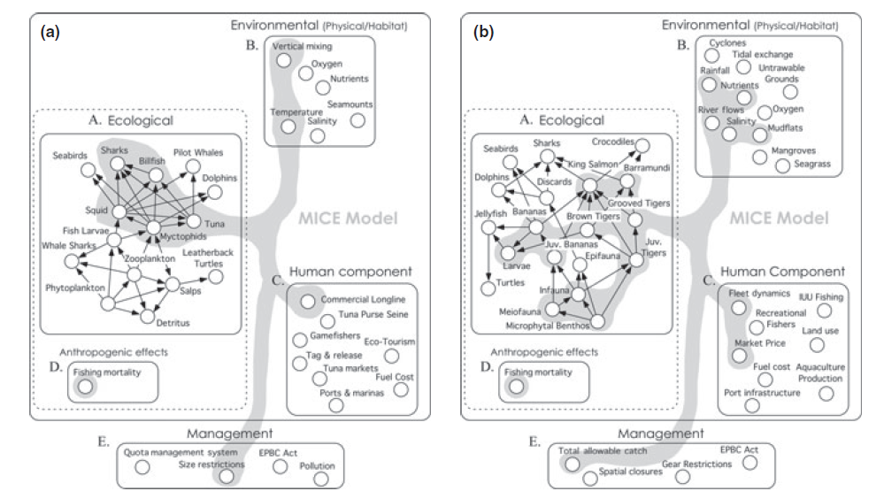
Models of Intermediate Complexity
Plagányi et al. (2014) Multispecies fisheries management and conservation: tactical applications using models of intermediate complexity. Fish and Fisheries. doi: 10.1111/j.1467-2979.2012.00488.x

Slide 27
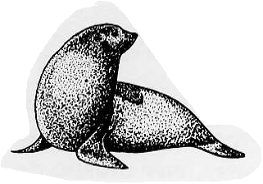
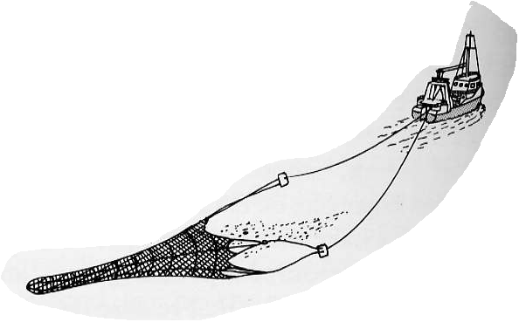
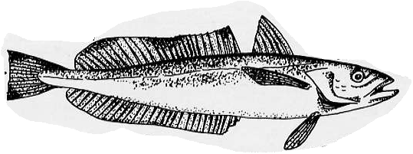
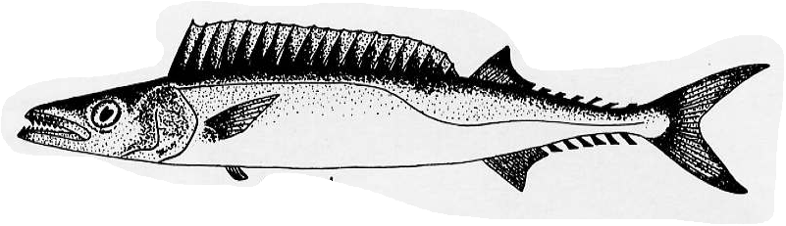



The South African Seal-Hake “Minimal Realistic Model”
Punt, A. E., & Butterworth, D. S. (1995). South African Journal of Marine Science, 16(1), 255-285.
Model Structures and
Management Systems
Management
Cull scenarios
Age-; sex-
structured
Catches
Fixed F
Species-; age-
structured
Delay-difference
A.E. Punt

Slide 28
Uses of MRMS/MICE
Most MRMs have been developed as the basis for strategic evaluations.
But many could be fit to data and also used to provide tactical advice.
Example: Fay et al. (2013, 2015), used auxiliary information to simulate multispecies dynamics for Georges Bank.
In principle the parameters can be estimated by fitting to data.
Well constructed MICE are based on extensive stakeholder consultation.

Slide 29
Challenges with multispecies reference points
Recall logistic growth model
Add single competitor
Dependence on biomass of other species.
Sometimes possible to solve system of equations to obtain maximizing population state vector.
But, implies decision about what is the ‘right’ population size for other species.
1

Slide 30
Fishery interactions with multispecies models
Multispecies Yield-per-recruit (MSYPR)
These add technical interactions to YPR models.
Similar to YPR models, but effectively focus on bycatch, mixed species fisheries.

Slide 31
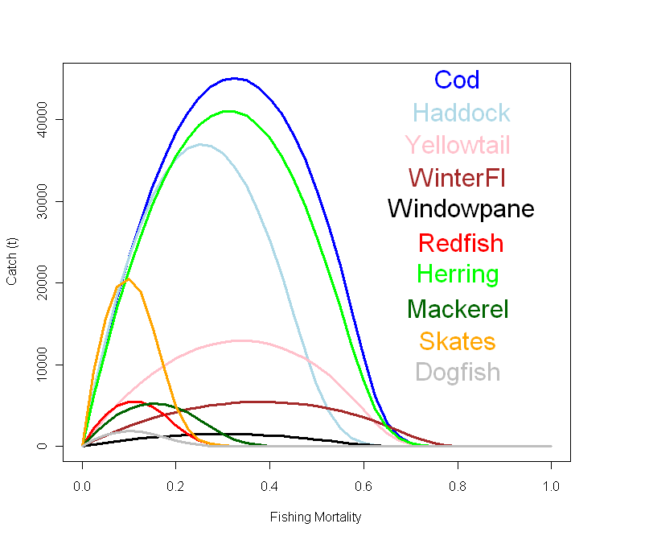
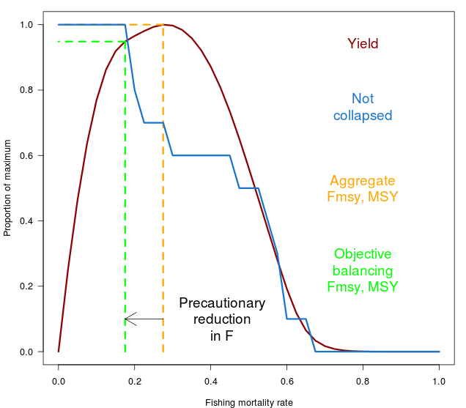
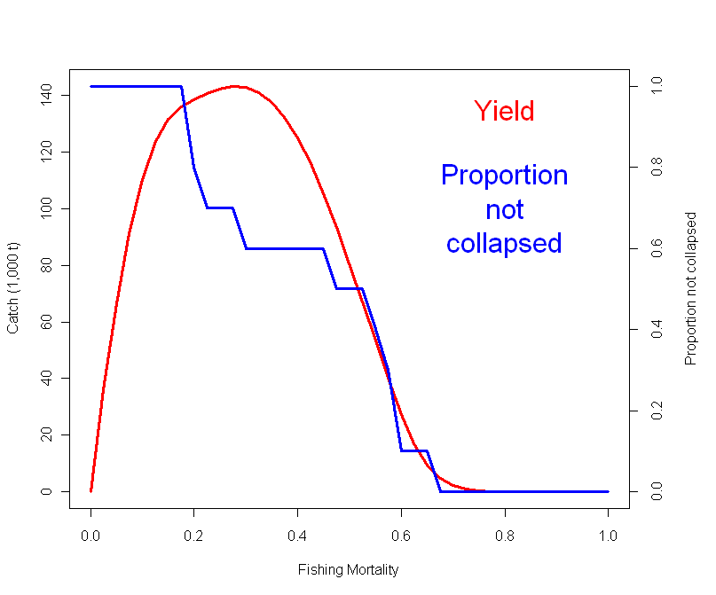
Simulations: balancing fishery/conservation objectives
Yield maximizing biodiversity is ~95% of MMSY
Gaichas et al. 2012 MEPS

Slide 32
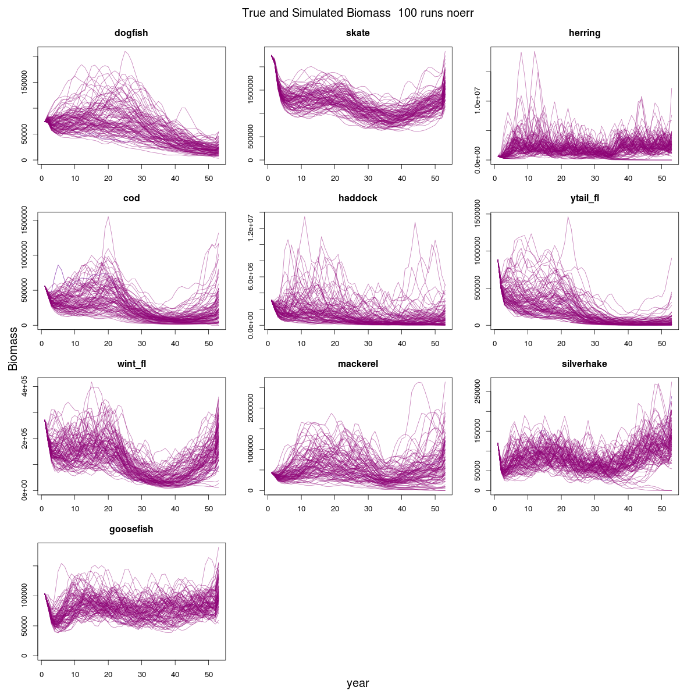

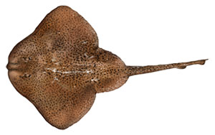
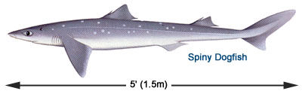
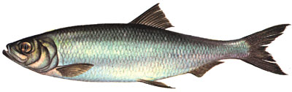

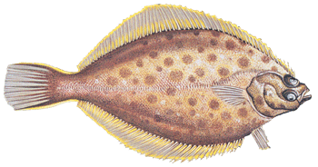
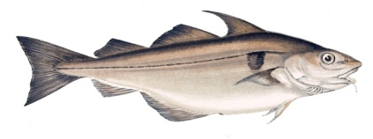
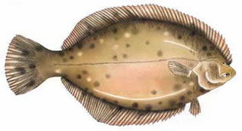
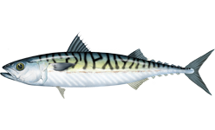
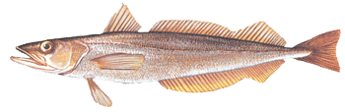
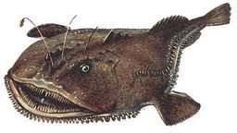
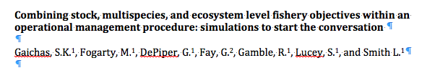

Slide 33
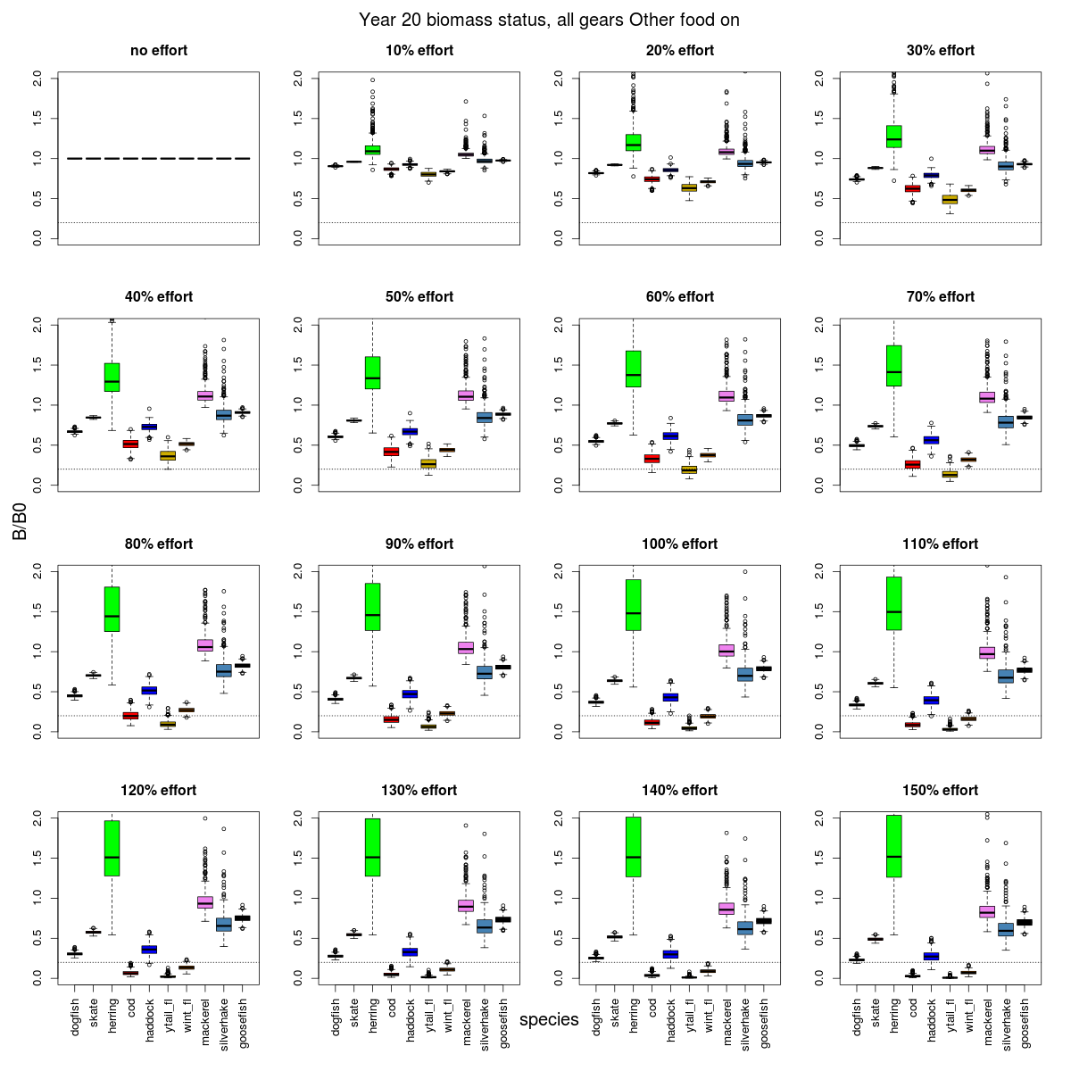

Slide 34
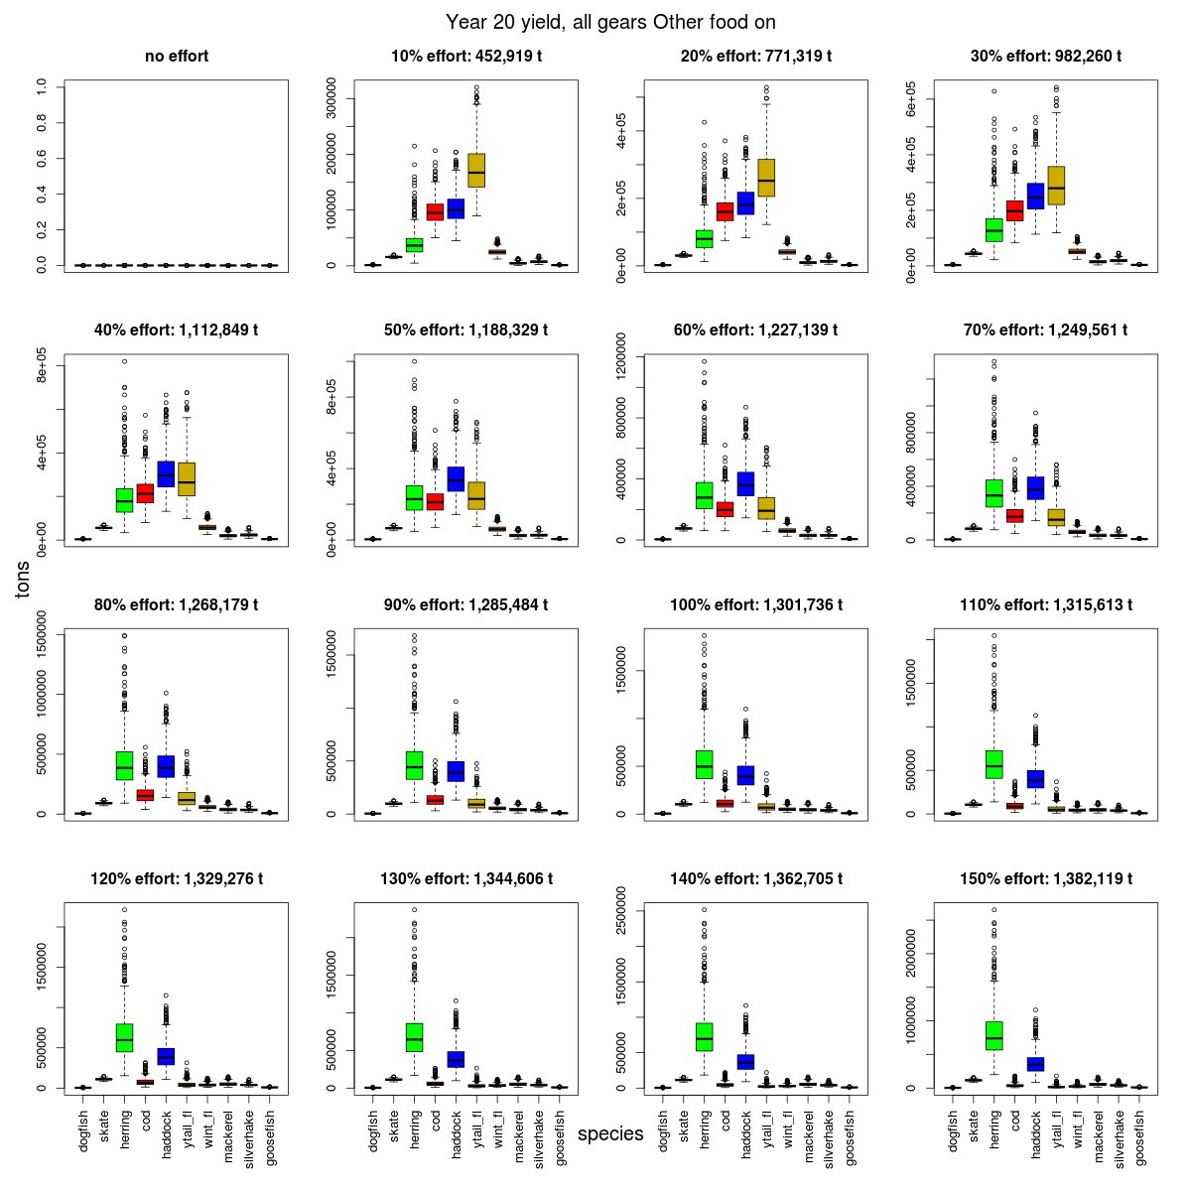

Slide 35
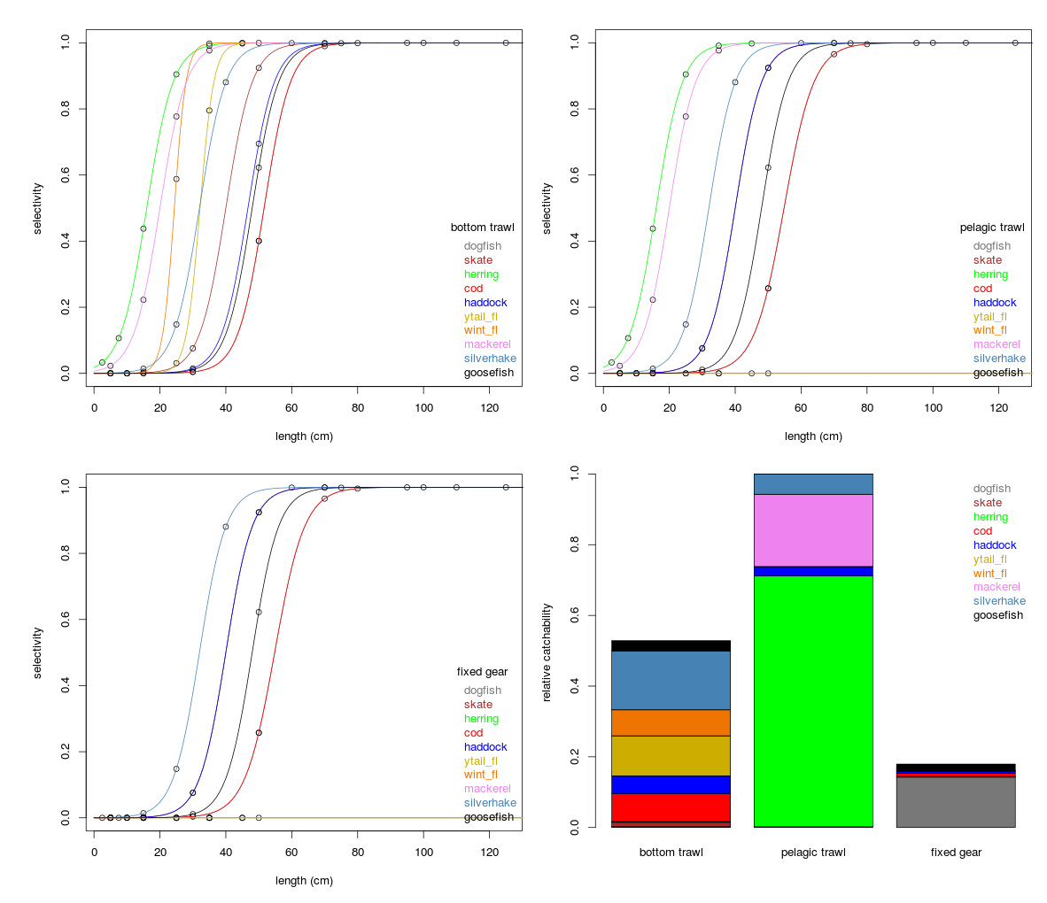
Three
fisheries: selectivity
and catchability

Slide 36
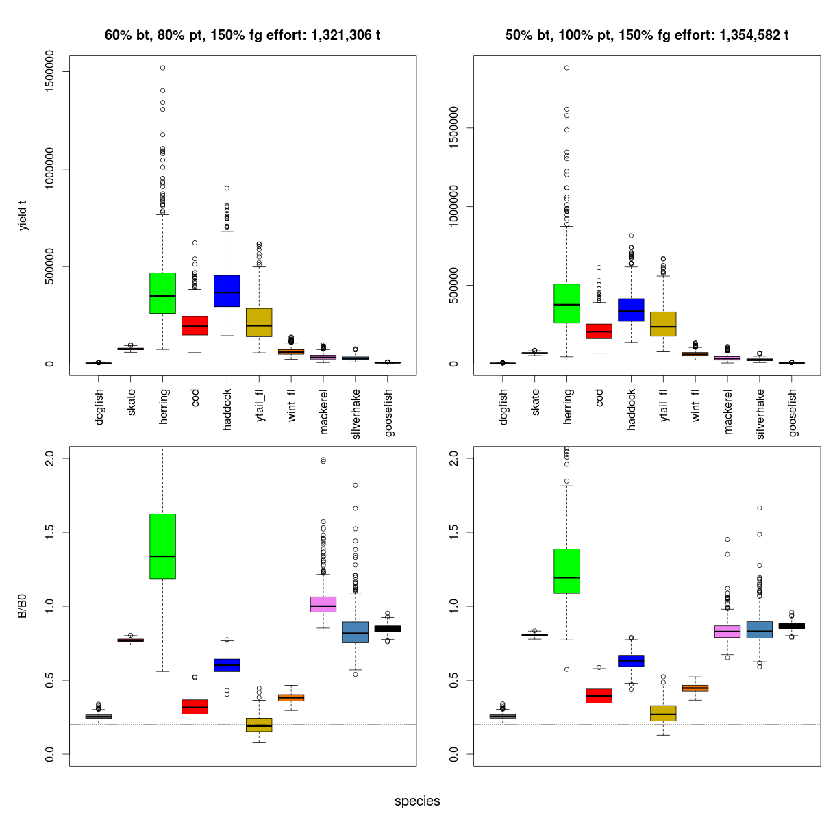
Can an improved mix of gears → higher yields?
+ ~15%

Slide 37
Simulations to evaluate multispecies fishery performance (Gaichas et al. in review)
Operationalizing EBFM requires strategies that address tradeoffs among species, and balance societal and ecological management objectives.
Aggregate fishing limits that maximize yield and conserve biomass exist
Community composition and (likely) value trade off across the range of fishing effort.

Slide 38
Multispecies Models and MRMs
Growing use of all types of models.
Continued development and enhancement of model construction.
Movement from heuristic to strategic/tactical applications.
These models are clearly more realistic!
Cost (data, institutional change) of application/implementation is high.
Rigorous evaluation of uncertainty / robustness required for general applications.

Slide 39
Advantages
Focus more specifically on restricted subset of system and problems.
Account for uncertainty more fully than whole of system models
Models can be structured to take advantage of available data.
Flexible nature can tailor model to specific systems and problems.

Slide 40
Disadvantages
Lack the detail and realism for evaluating complex systems.
Possibility of choosing the wrong key species and interactions.
Custom built, time consuming and labor intensive for individual applications.

Slide 41
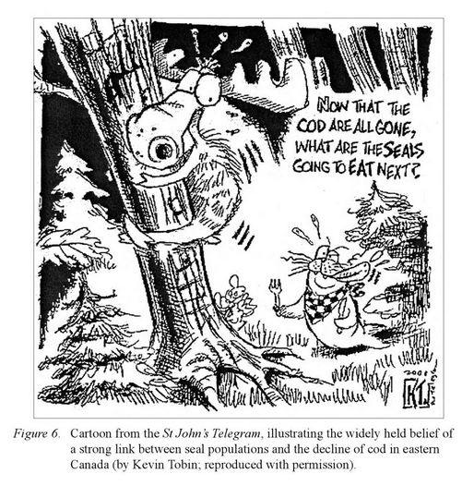
Functional responses matter
Pinnegar et al.

Slide 42
Multispecies Models
Questions?

Slide 43
Next time on Models for Marine EBM….
Marine Spatial Planning Models
Marine Reserve Design
Lab using Marxan

Slide 44
LAB

Slide 45
Lab 1/3
Quick Intro to MARSS package
Wolves & Moose

Slide 46
Lab 2/3
Diet composition of Georges Bank piscivores
Parameters/data in ‘species_params.csv’
Use Hall et al. (2006) type II functional response and biomasses to compare diet comp predictions to data proportions.
Use the parameters in Hall et al. to estimate the diet composition for cod and dogfish.
(hint: tweak ‘other food’)
Use LM50 to work out the body size ratios.
Compare the predictions to the diet data – do the theoretical relationships make sense?
What would you suggest as a next step?

Slide 47
Lab 3/3
Fishery policy evaluation using Ecosim
Use Anchovy Bay model
Assume no sealing.
Run scenarios varying level of trawling effort.
Find the effort leading to maximum long-term yield for the trawl fishery.
Plot and discuss implications for species biomass, mix of species in trawl catch, impact on other gears associated with fishing at maximum yield for trawl.
BONUS: do solutions exist for effort levels of other gears?

